Slide 1

Online Auction Management System
Welcome to the Online Auction Management System, a web-based platform designed to facilitate seamless trading between buyers and sellers. This system offers a wide array of features for managing auctions, handling transactions, and ensuring a secure and engaging user experience. Admins play a crucial role in maintaining platform integrity through auction approvals and user management. With the online auction market projected to reach $250 billion by 2028, this platform is poised to capitalize on significant growth opportunities.

Slide 2

User Registration and Account Management
The Online Auction Management System simplifies user registration with an intuitive process. New users can quickly create accounts, ensuring secure logins and robust password management. User profiles allow for easy updating of personal information, providing a personalized experience. With platforms like eBay boasting 135 million users in Q4 2023, a seamless user experience is paramount.
1
Easy Sign-Up
2
Secure Login
New users can quickly register with minimal information.
Robust password management ensures account security.
3
Profile Updates
Users can easily manage and update their personal information.

Slide 3
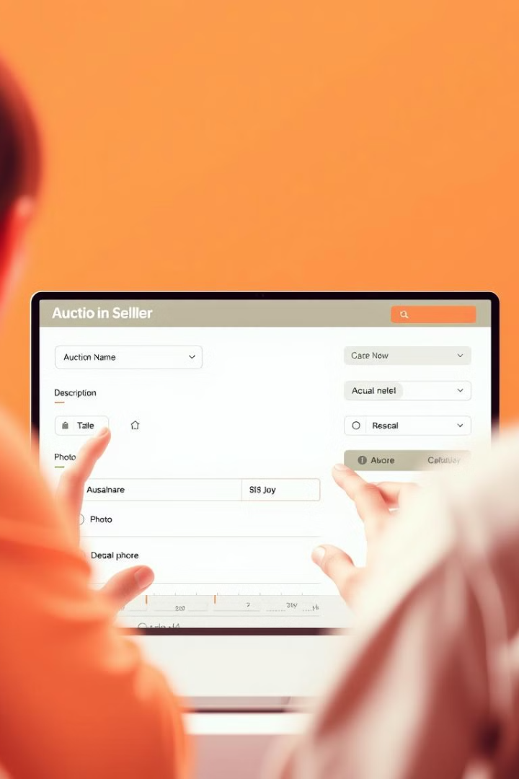



Creating and Managing Auctions
Creating an auction is straightforward, beginning with a name and description and a photo upload to showcase the item. Sellers set the duration and starting price, retaining the flexibility to extend the auction if no bids are placed. This feature maximizes the chances of a successful sale. With an average auction listing conversion rate of 45% across platforms, this streamlined process enhances user engagement and success.
Auction Details
Name, description, and photo upload.
Set Duration
Define the auction length and starting price.
Extend if Needed
Option to extend if no bids are placed.

Slide 4
Bidding and Buying Process
Buyers can easily browse and search auctions, place bids, and monitor the auction's progress in real-time. Notifications keep buyers informed of outbid alerts and auction updates, ensuring they never miss an opportunity. Secure payment gateway integrations, such as PayPal or Stripe, guarantee safe and reliable transactions.
Browse Auctions
Place Bids
Secure Payments
Find items easily using search and categories.
Participate in auctions and track progress.
Use integrated gateways like PayPal and Stripe.

Slide 5
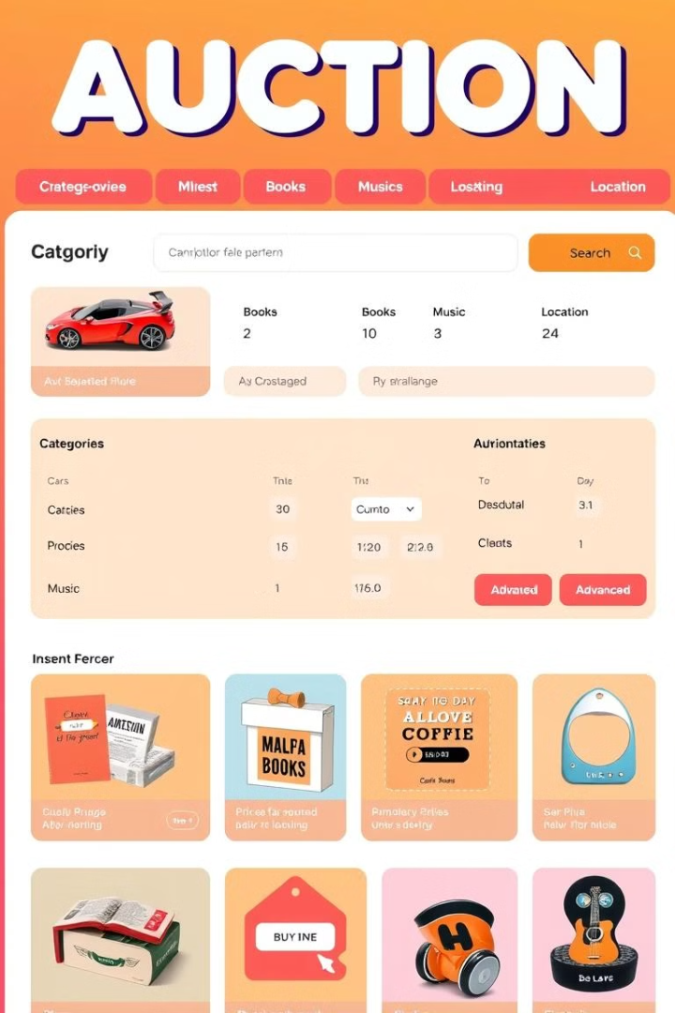
Auction Categories and Search Functionality
The platform offers a wide array of auction categories. Advanced search filters enable users to find desired items quickly. Category-specific browsing further simplifies the process, allowing users to focus on their interests. For instance, the "Cars" category sees an average of 5,000 new listings weekly, showcasing the platform's breadth.
Cars
Books
Extensive selection of vehicles for auction.
Rare and popular titles available.
Music
Vinyl records, instruments, and memorabilia.

Slide 6
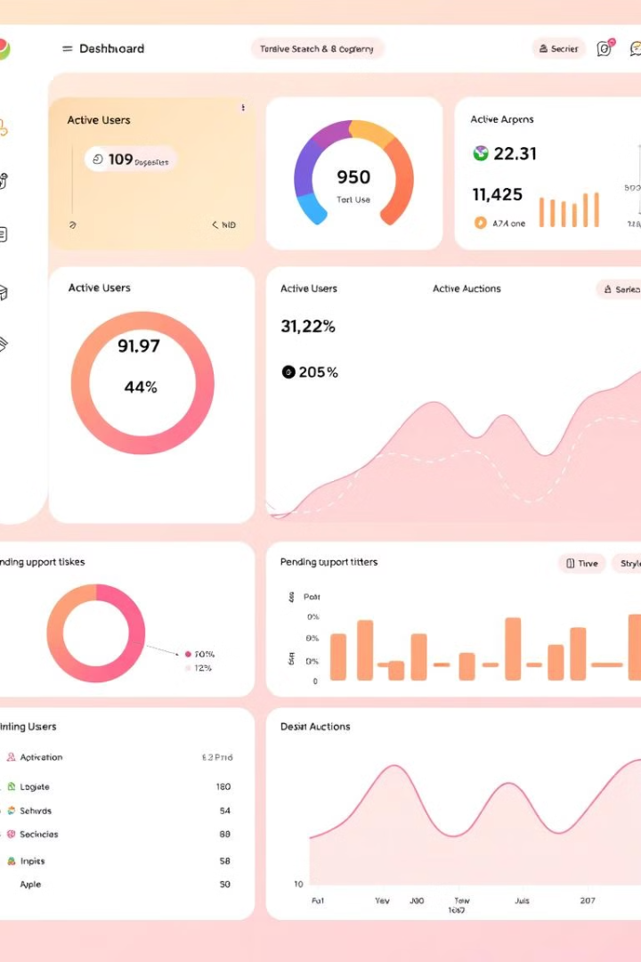



Admin Dashboard Overview
The admin dashboard provides a centralized hub for managing the platform. Key metrics, such as active users and auctions, are prominently displayed, providing insights at a glance. System performance is easily monitored, ensuring optimal functionality. This comprehensive overview empowers administrators to make informed decisions and maintain platform health.
Active Users
Active Auctions
Support Tickets
Track user engagement and growth.
Monitor current auction activity.
Manage and resolve user issues.

Slide 7



Auction Approval and Rejection
Administrators carefully review new auction listings. Approval or rejection is based on established guidelines, maintaining platform integrity. Clear communication with users regarding their auction status ensures transparency and trust. Daily active moderation is a key feature.
2
Apply Guidelines
1
Review Listings
Communicate Status
3

Slide 8



User and Item Details Management
Admins have access to comprehensive user profiles and transaction histories, enabling detailed oversight. They can view and manage item details, ensuring accuracy and compliance. Tools for resolving disputes and handling user complaints are readily available, fostering a positive community environment. A user rating and review system further enhances quality control.
Item Details
1
Manage Listings
User Profile
2
Details of user
Transaction History
3
Purchase logs

Slide 9
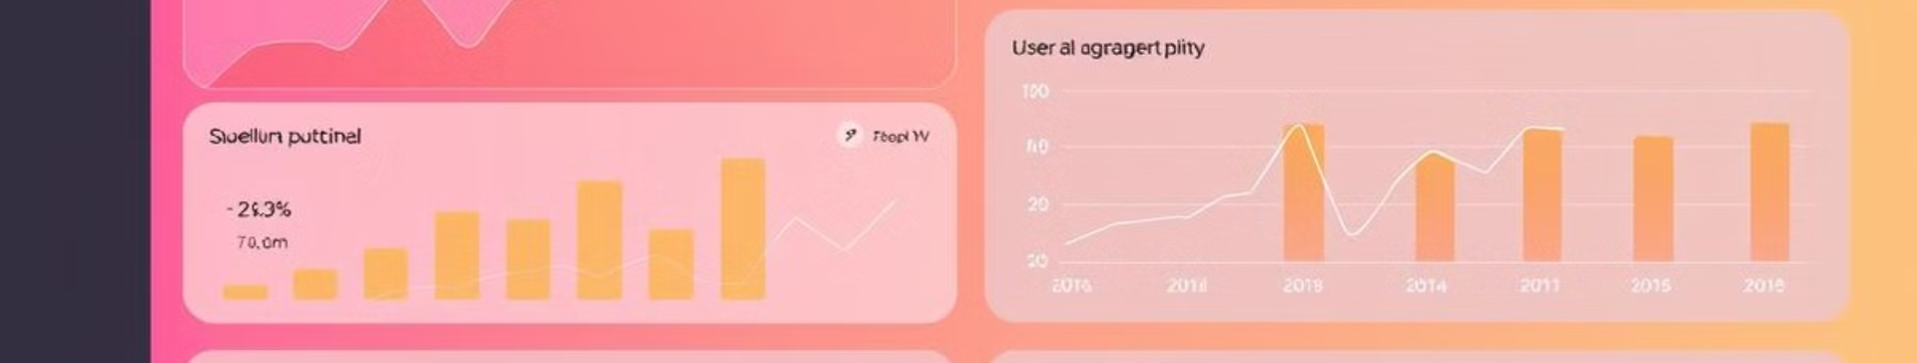
Reporting and Analytics
Detailed reports on auction activity can be generated, providing valuable insights. Key performance indicators (KPIs) are tracked, enabling data-driven decisions. These analytics support platform optimization, identifying trends and areas for improvement. Reports on the most popular auction categories inform strategic adjustments.
250K
12K
$5M
Active Users
Daily Auctions
Revenue
The growth of active users in the platform.
The number of auctions completed in a day
The total revenue generated.

Slide 10

Conclusion and Future Enhancements
The Online Auction Management System offers significant benefits, ensuring efficient and secure trading. Future plans include mobile app development and AI-driven recommendations. With the online auction market expected to grow 15% annually, this platform is set for continued success. We invite potential users and investors to join us in shaping the future of online auctions.
1
Mobile App
Develop a mobile app for iOS and Android devices.
2
AI-Driven Recommendations
Implement AI to enhance user experience.
3
Strategic Growth
Grow in annual revenue year over year.

